Slide 1
Inclusive Placement Opportunities for Preschoolers: A Systems Approach to Preschool Inclusive Practices
A project of the Virginia Department of Education and the Technical Assistance Centers of Virginia
Notes:
Note to presenter: This module can be changed to reflect the needs of your audience; save the presentation to a location on your computer and make necessary changes.
This module contains activities to promote participant involvement aimed at improving retention of information presented. To learn more about participant-centered training strategies please refer to: Pike, R. (2002). Creative teaching techniques handbook: Tips, tactics, and how-tos for delivering effective training (3rd ed.). Amherst, MA: HRD Press. Or visit the Web site at www.bobpikegroup.com.

Slide 2
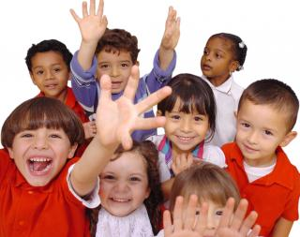
Module 3: Fostering Social Relationships: A Class-wide Approach
Notes:
In inclusive environments, we can’t assume that because young children with and without disabilities are together that they will interact and successfully develop relationships. This module will provide you some strategies that will help to foster social relationships between children.

Slide 3
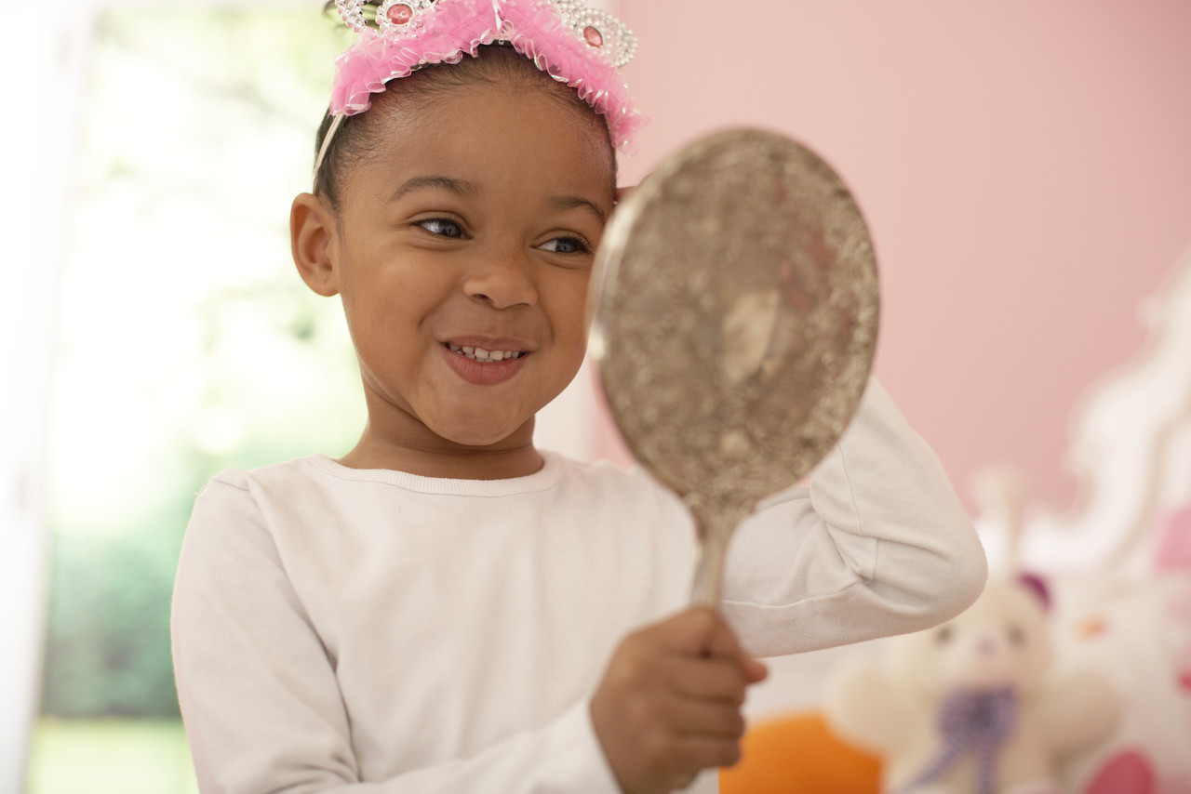
Mirror, mirror
Notes:
Activity: Ask the participants to reflect on their experience as a young child.
Ask: How did the adults in your life support your social emotional development? What had a positive or negative impact? Would anyone like to share their reflections with the larger group?

Slide 4
Agenda
A few facts
Why it’s hard to teach social skills
What the research says
The teacher’s role
Teaching strategies
Notes:
During our time together we will address the above.

Slide 5
Teach Social Emotional Skills to Young Children
Why?
What?
When?
How?
Notes:
Share with participants that during the course of our time today we will discuss what the research says about why social-emotional skills are so important to develop in young children. We will also discuss what specific skills are necessary for young children to be successful in both school and community environments.
Research tells us that there are more appropriate times during the day to teach social skills, so we’ll be talking about that as well.
Finally, we will discuss strategies that can be used to promote the acquisition of social-emotional skills.
Why? (Discuss research)
What? (Identify the skills that children need to learn)
When? (Within your daily schedule)
How? (Activities and strategies implemented to get you there)

Slide 6
Which social emotional skills most likely lead to positive outcomes later in life?
Notes:
Activity (have chart paper and markers for each table): Ask teams to discuss the above question and record their responses on chart paper at their tables. Point out that most answers are related to forming relationships and friendships.
Most young children form friendships in preschool. This is in part because they learn social skills as a direct result of interacting with their peers. Social skills such as greetings and reciprocity in personal exchanges evolve in most children as they begin forming relationships with their peers. Therefore, teachers often do not find it necessary to purposely foster friendships between young children.
Many children with disabilities do not spontaneously develop friendships with their peers because they either do not know how to interact or they have other behaviors that are interfering with their ability to interact appropriately with their peers. Children with disabilities often play alone or next to another child. In many cases, interactive play only occurs with adults. Often when peers try to initiate interaction with children with disabilities, these children respond inappropriately or not at all and as a consequence the other children stop trying to interact.
As a result, this question is of extreme concern considering that social skills are almost always the answer and the deliberate fostering of social relationships between young children with and without disabilities is a primary goal of preschool inclusion.

Slide 7
Key Social Emotional Skills Children Need as They Enter School
Confidence
Capacity to develop good relationships with peers and adults
Concentration and persistence on challenging tasks
Ability to effectively communicate emotions
Ability to listen to instructions and be attentive
Ability to solve social problems
What do children do when they don’t have each of these skills?
Notes:
Review the key points on the slide, then ask participants if they notice if any skills are missing from their perspective
Ask: What happens when children don’t have these skills?
Have them think about children in their settings who don’t have these skills.
What have they noticed about their behavior and ability to form friendships? (Answers might include everything from specific challenging behaviors to quiet and withdrawn).
How do we help children learn these social emotional skills?( We “teach” them!)

Slide 8
Consider the Facts…
One of every four children has been exposed to a traumatic event that can affect learning and/or behavior
Trauma can impact school performance
Trauma can impair learning
Traumatized children may experience physical and/or emotional distress
You can help a child who has been traumatized
Child Trauma Toolkit for Educators, October 2008, National Child
Traumatic Stress Network, www.NCTSN.org
Notes:
Today we know that we are more likely to have preschool-aged children who have been exposed to traumatic events. These events can have an impact on their development, which includes the acquisition of social-emotional skills.
While we will not be addressing trauma sensitive strategies today, we do refer to the resources on the slide, so that you can gain more information about trauma sensitive practices.

Slide 9
What Would You Do?
The only person you know at the party walks away to talk to someone else. Would you…
a) pull out your cell phone
b) strike up a conversation with someone else
c) get something to eat or drink
d) follow your friend
Notes:
Think about yourself in the situations listed on this slide.
Read each scenario (this and next 2 slides) and ask participants to think about them. Then ask participants how they would feel in these situations and how they would respond.
Activity: Four Corners

Slide 10
What Does the Research Say About Friends?
Emotional regulation
+
Social knowledge and understanding
+
Social skills
=
Prosocial Skills
Notes:
In the next several slides, we will cover these components in depth and talk about how they relate to one another

Slide 11
Emotional Regulation
Control impulses
Manage distress
Delay gratification
Notes:
The development of emotional regulation is a major accomplishment of early childhood. It involves the ability to control impulses which, as we know, is very difficult for many of our young ones. They grab, yell, and hit. “I want it and I want it now” is often the motto of some children we support.
A related skill is the ability to delay gratification. As children grow and mature they develop the ability to pause and think, “I can wait until you are done with the truck.” But some children with disabilities need our support to delay gratification.
Share information about the The Stanford marshmallow experiment^{[1]} (presenter may choose to show the video the actual test--embedded video) was a series of studies on delayed gratification in the late 1960s and early 1970s led by psychologist Walter Mischel, then a professor at Stanford University. In these studies, a child was offered a choice between one small reward provided immediately or two small rewards if they waited for a short period, approximately 15 minutes, during which the tester left the room and then returned (the reward was sometimes a marshmallow, but often a cookie or a pretzel). In follow-up studies, the researchers found that children who were able to wait longer for the preferred rewards tended to have better life outcomes, as measured by SAT scores,^{[2]} educational attainment,^{[3]} body mass index (BMI),^{[4]} and other life measures.
And the ability to manage distress also plays a part in being able to regulate emotions. While a child may be able to control his impulses and emotions and wait for another child to finish with the truck, he must also not go to the corner and cry about it.

Slide 12
Social Knowledge and Understanding
Language
Take other’s perspective
Reach common ground
Experience
Notes:
Children also need several kinds of social knowledge to be able to form friendships.
They have to have language or a way to communicate with their peers — to be able to greet a friend and to be able to join in play by using the language of the play. If two children are playing restaurant in the dramatic play area and a child who is non-verbal wants to join them, he needs a way to tell the others, “I’d like French fries please.”
Socially competent young children synchronize their behavior with their peers by establishing common ground. They exchange information and explore similarities.
Ask: What do we talk about with adults that we don’t know very well? (Pause and wait for participants to answer.) Often, the weather is what we talk about; its common ground, we all experience it and know about it.
And children with social knowledge and understanding have had experience. They weren’t born knowing how to interact and make friends. They learn through their experiences with others.

Slide 13
Social Skills
Enter ongoing play
Imitate
Ask for help
Help others
Compliment
Show affection
Organize
Construct
Negotiate
Take turns
Express self
Gather information
Persist
Pretend
Cooperate
Notes:
Social approach skills are central to social participation and success.
Many of the interactions in preschool consist of efforts to gain access to play groups and to resist efforts of others to enter their play groups. The literature says that the ability to enter ongoing play is one of the most important skills children need to be able to develop friendships.
Other important skills include those listed on the slide.

Slide 14
Definition of Pro-social Behaviors
“A broad range of actions intended to benefit one or more people other than oneself - behaviors such as helping, comforting, sharing, and cooperation”(Batson, 2003).
Batson, C.D. (2003). The handbook of social psychology. Retrieved on September 10, 2018, from https://eric.ed.gov/?id=EJ959719
Notes:
We have been talking about the development of social-emotional skills. However, you may hear the term pro-social behavior. These two terms are interchangeable but don’t be confused by the terminology.
Read quote from Batson (from The Handbook of Social Psychology https://eric.ed.gov/?id=EJ959719)
Children have to be pro-social to make friends. Socially competent children are those who engage in satisfying interactions and activities with adults and peers and through such interactions improve their own competence.
Presenter can share this additional resource:
Hyson, M., & Taylor, J.L. (2011). Caring about caring: What adults can do to promote young children’s pro-social skills. Young Children (pp. 74-83).

Slide 15
Think About Children Who are Well Liked…
What do you notice about their behavior that makes it easier for them to have friends?
Form groups of three
Assign a recorder
List the specific skills that child demonstrate with friends
Notes:
Now let’s talk about what social skills we see in children who have friends.
Activity: Divide into groups or discuss as a whole group and record on chart paper,
Discuss the specific skills that children who are well liked use with their peers.
Have a recorder write them down.
Remind the group to write down specific, observable skills.
Ask groups to share what they come up with. Add anything that is left out as the groups/individuals share out.

Slide 16
What We Know
Interaction is reciprocal and ongoing
Children learn best when they are in control of their learning
Interaction is learned through practice
Interactions can be negative or positive
Negative interactions change when adults intervene
Notes:
Share the bullets above with the participants and add the following as talking points:
Interaction is reciprocal – in order to have a meaningful interaction with someone, whether through conversation or in the case of young children play, both parties must contribute. In conversation, you say something, and the party you are addressing responds. In play, a child might start playing with blocks and another child joins in. If this serve and respond type interaction is not maintained, interactions stop or never begin.
Control of learning – young children need lots of choice in the activities they engage in and who they engage with. If they show an interest in certain materials or activities they are more likely to engage longer.
Interactions are learned - young children learn from what is modeled to them. It is important to model positive interactions through peer models. If negative interactions are observed, adults should intervene and model a more appropriate interaction. Always remember how important reinforcement is for increasing appropriate interactions.

Slide 17
Do We Always Practice What We Teach?
Greet the parent but not the child
Talk to the parent or another teacher about the child in front of the child
Attribute needs to children
Label a child’s behavior
Refer to a child by a label
Notes:
We also inadvertently model behaviors that don’t reinforce what we teach.
How many of you have had adults say “Good morning” to you but totally ignore the child? Is that socially appropriate?
And is anyone guilty of talking about children in front of them? Would we do this if it were another adult?
And sometimes we talk about children, giving them attributes in front of them by saying things like, “Oh, he’s being shy today.” Or we label the child’s behavior or refer to a child by a label.
Think about the example that we are setting when we do these things.

Slide 18
Why are these ineffective ways to teach pro-social behavior?
Telling a child to say he is sorry
Telling a child she is rude for interrupting others
Telling a child who is hanging on tightly to an adult that he is “feeling shy”
Asking a child, “Why did you hit?”
Asking a child to sit for two minutes to calm down
Notes:
Activity: In pairs, have participants review each of the above and share with each other why these strategies would not be helpful in teaching pro-social behaviors. Be prepared to share thoughts about one of the ineffective strategies listed on the slide. Once participants share, if certain points are not mentioned, then presenter can fill in the following information:
Telling a child to say s/he is sorry – Many times young children just repeat what they are told. They do not understand why what they did or did not do was inappropriate. Teaching them what else they could do is more effective than just requiring an apology.
Telling a child s/he is rude for interrupting two people talking – Young children are very egocentric; they want to get someone’s attention immediately. In addition, they do not understand what “rude” means. They want their needs met and see interrupting as an appropriate way to do this. We must teach them appropriate ways of gaining attention instead of just saying they were rude.
Asking a child, “Why did you hit?” – This is asking the question that we already know the answer to; they wanted something, whether it was an object or attention, and this produced the quickest results. When asked, most children will say “I don’t know.” Again, teaching them alternative ways to get their needs met is more effective.
Asking a child to sit for two minutes to calm down – Asking them to sit to calm down may work, but you must follow with the teaching aspect. Explain why they need to calm down and what behaviors they could have used instead that would get the results they desire.

Slide 19
Setting the Stage to Promote Relationships
Structure the environment
Teach social skills
Encourage classmates to interact
Use child-specific strategies to foster social relationships
Notes:
The teacher sets the stage by structuring the environment, teaching the social skills that the child needs, supporting classmates to play with and interact with their peers, and using child-specific strategies.
Let’s take a look at each of these areas of setting the stage.

Slide 20
Structure the Environment
Thoughtful schedule
Planned environment
Physical inclusion
Pro-social class expectations
Positive statements
Notes:
The way we structure the environment is through scheduling, careful planning of space, developing class expectations for behaviors, and making positive statements.

Slide 21
Thoughtful Schedule for Pro-social Behavior (Slide 1)
Balanced
Predictable routine
Advance warning if changes occur
Alternative activities
Short clean up with active child involvement
Notes:
Refer to Module on Setting up the Environment if you want to provide any additional information, in-depth examples of this presentation
Show the Video 1.3 Visual Schedule: https://drive.google.com/open?id=1k-6Y2CvUGUJq6Bh5wrfNBBM4zJikdJQG
Elaborate by discussing the following talking points:
1. In terms of the schedule, it should be balanced. This refers to making sure that the schedule is mainly teacher-planned and child-initiated with some activities that are teacher-guided or for large groups (e.g., mainly child-initiated, some teacher-guided, and few large group activities).
2. Children should know what to anticipate each day, including what happens when they arrive and during center or circle time. This routine helps them feel that they have control over their environment. For young children, a visual schedule provides more structure and helps them understand what happens at each part of the day. This can take the form of pictures that help guide them through the day’s activities.
3. To help children anticipate schedule changes, give as much advance warning as possible. For example, explain to a child that, “Today we are having a guest visitor,” and have a picture symbol that demonstrates this change to share.
4. Provide children with choices of alternative activities to accommodate different energy levels and attention spans.
Keep in mind the following in order to promote pro-social behavior: cooperation and smooth transitions

Slide 22
Thoughtful Schedule for Pro-social Behavior (slide 2)
Pre-correction
Planned transitions
Materials set up in advance
Quick starts for activities and defined teacher roles
Notes:
A thoughtful schedule requires attention to details such as (share each bullet from the slide)
Pre-correction – show children the correct way to interact before they enter into the interaction – If a child is about to enter the block area, point out that when in blocks you share (give others access to the blocks, ….).
Planned transitions – transitioning from one routine to another throughout the day takes time and must be planned. How will you signal the children it is time to leave one activity to go to another? Bell, song, lights? Ask participants what else they might do. How will you provide a further prompt for children who need more than the overall classroom prompt (whisper in their ear that it is almost time to change, show them a visual symbol, use a timer…)?
Materials set in advance and teacher roles – all materials for all activities should be set up in advance so that the activity can begin right away. It is important if several adults are in the room that each knows what to do when (teacher moves on to activity while assistant cleans up, sets up next activity, etc.). This will allow for quick starts to activities and less down time which may contribute to inappropriate behaviors.

Slide 23
5 Minute Glove
Retrieved from https://vimeo.com/194715354
Notes:
Refer to the video 1.8 Five Minute Glove in the folder.
Ask: What other successful strategies have you seen or used for transitions?

Slide 24
Planned Environments
Ensure physical inclusion
Socio-dramatic materials in each center (social toys)
Plan groupings of children with and without disabilities
Plan teacher-structured activities
Well defined areas
Quiet and loud zones
Quiet spot
Notes:
Being mindful about how you setup your environment can facilitate the acquisition of social emotional skills.
Briefly review the points on the slides and provide the resource of How to Use a Quiet Spot.
Refer to the handouts section of this module.

Slide 25
Well Defined Areas
Notes:
Here is an example of a classroom that has well defined areas. Note the way that shelving is used to divide spaces.

Slide 26
Physical Inclusion
Children should:
Have access to all toys and materials and all parts of the room
Be at the “same level” as other children (e.g., sitting, standing)
Participate in all activities (e.g., adapt materials)
Notes:
See social handout , Steps on Fostering Children’s Friendships., located in the module 4 handout folder.

Slide 27
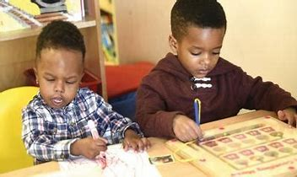
Strategy: Social Toys
Turn to the person sitting on your right and together list toys or materials in your classrooms that encourage social interaction.
Notes:
Activity: Participants to turn to the person sitting on their right and make a list of toys in their classrooms that encourage social interaction. Also think about ways you may need to adapt toys/equipment for young children with physical disabilities that promote their social interactions (e.g., prone stander, wedge, floor sitter).
Have participants volunteer to share what they listed in the previous activity.
If they did not include any of the items list below during the report out, presenter will discuss how each of these toys promote social relationships or not.
(refer to handout, Uses for Toys and Materials in Pro-social Ways in the Early Childhood Classroom
Examples of toys: How do you use toys to promote social skills?
Dress-up clothes
Dramatic play materials
Puppets
Vehicles
Sand/water toys
Record player
Blocks
See saw
Kiddie car
Jungle gym
Puzzles
Pegboards and pegs
Art materials
Parquetry
Shape templates
Toy animals
White/black board
Dolls
Beads
Felt board stories

Slide 28
Strategy: Planned Groupings
Small groups include children with disabilities and typically developing children
Avoid “shadowing”
Notes:
Carefully construct small groups, making sure to have children with varying abilities in each group.
Try to avoid having the child with a disability always with an adult (shadowing). If the child needs support, determine if a peer can provide it.

Slide 29
Support Children to Develop Friendships
Notes:
Now that you have carefully planned your environments, let’s watch this video clip and look for specific strategies you can use to help children develop friendships.

Slide 30
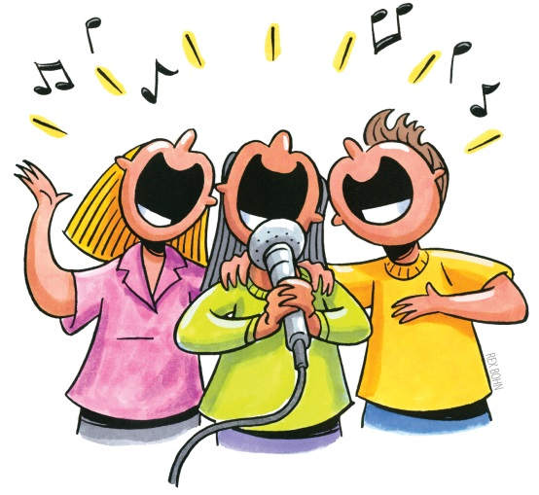
Teacher-Structured Activities
Modify songs and activities
Provide cooperative materials
Notes:
Modifying songs and activities to include directions for displaying affection
“If you're happy and you know it,” hug instead of clap
Simon says “Touch your friend’s head”
Musical chairs where you must all fit in a chair instead of leaving someone out. Students would have to sit in laps and share chairs.
Cooperative materials that require two or more children to use:
String beads on opposite ends
Pour juice
Carry a ball between two children
Build a project together
Paint a mural
Clean the table, sweep the floor
Blanketball
Ask: Can you add some additional activities?

Slide 31
Teacher-Structured Activities (con’t.)
Direct modeling and modeling with puppets
Prepare peer partners
Use positive feedback and encouragement
Use social stories
Notes:
Show video 2.8 Embedding 2 (teacher facilitating peer-mediated learning at water table and paint easel) https://drive.google.com/open?id=1IekVvdTnooHEL0xCDyiDJQpJHzvn-JHx
Let’s review some strategies that you as the teacher can use.
It is always important to model strategies that promote friendships for young children, but remember to also use puppets.
Peers can be taught to initiate play and to sustain play, so you can teach them how to continue to engage.
Remember to provide positive feedback when children use friendship skills.
See resources for social story

Slide 32
Develop Behavior Expectations that Promote Pro-social Behaviors
3-5 positively stated expectations
Posted visually and at children’s eye level
Linked to social emotional competencies for young children
Notes:
Set behavior expectations for the classroom that are geared to cooperation and friendship.
Remember to teach the expectations by demonstrating to the children what each behavior looks like.
Model, have photos, and practice using the skills in the appropriate locations.

Slide 33
Demonstrating Rules
Retrieved from https://vimeo.com/194716054
Notes:
Show video 1.13
It shows how the teacher reviews and teaches the classroom expectations.

Slide 34
Praise: It’s All In How You Say It!
Provide behavior specific praise
Make children aware of their thinking and self-control
Connect praise to prior accomplishments
Verbally reward effort
Orient the child to his feeling
Connect to internal rewards
Offer praise in private
Be genuine
Notes:
Share the Praise handout (the one with the Smiley face) and cover the points on the slide.
Provide feedback to the child that is specific and tells exactly what s/he is doing – “ You should feel good that you shared the toy with Sue.” “You remembered not to pull the toy away from Sue.”
Activity: Presenter can use an additional praise handout for participants to do an activity. This can be found in the handout folder. There is one called Specific Labeled Praise. Participants can practice doing praise examples.

Slide 35
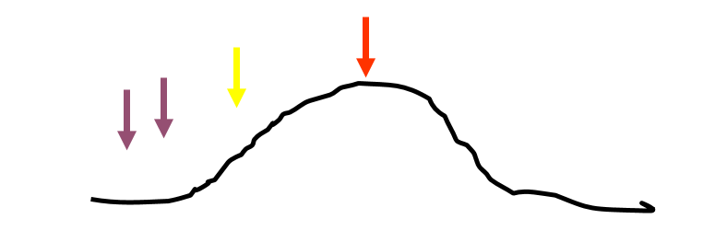
Teach Social Skills
Identifying teachable moments
Notes:
The best time to teach social skills is before there is a problem. This is true when also teaching skills in other settings such as home and in the community. Multiple opportunities to practice will help young children to generalize these skills across settings where they spend time.

Slide 36
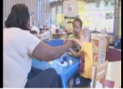
Embedding Social Skills into Routines and Activities
Retrieved from https://drive.google.com/
open?id=1arm2Vkz9NA162-gKIVEprS8VTWl0g4yt
Notes:
This short video clip illustrates how the teacher focuses on helping each other all day long. https://drive.google.com/open?id=1arm2Vkz9NA162-gKIVEprS8VTWl0g4yt
Let’s take a look at how this teacher is using the daily routines to embed and teach the use of social skills.
Ask the participants the following question:
How did she relate the social-emotional skills that are important for the children to use, as it related to the lesson (i.e. ants working together)?
Note her intentional use of social skills during this routine.

Slide 37
Friendship Skills
Create play opportunities (play organizers)
Sharing toys and other materials
Taking turns (reciprocity)
Being helpful
Giving compliments
Understanding how and when to give an apology
Notes:
We are going to explore some of the skills that children might be taught as discrete social skills. When children have these skills, it makes it easier for them to have more positive experiences when playing together and making new friends.

Slide 38
Play Organizers
Retrieved from https://vimeo.com/194717297
Notes:
Let’s take a look at this video clip.
Just a side note, the children in this video did not know each other before they were videotaped playing together. While watching this video, pay attention to the social skills they are using during this interaction.
Ask: What skills were children using that contributing to such a successful interaction?
This demonstrates that when children have these skills, it makes it easier for them to have positive experiences with peers.

Slide 39
Play Organizers (Slide 2)
Describe
Get friend’s attention
Give friend a toy
Give idea for what to do with toy or what to play
Demonstrate
“Right way”
“Wrong way”
Practice
Promote
Notes:
Let’s take a look at the Friendship Skill of how to organize play. As you see on the slide, there are several discrete skills for children to use to enter into play with one another. These include: get your friend’s attention, offer a toy, offer a toy or prompt to encourage to play together. It’s important to break down what skills are missing that keep children from being able to organize their play.
Refer to the handout: Social Behaviors Used between Friends and Sample Teaching Strategies
This handout includes an informal assessment of social behaviors that is based on observation that can be used to determine what specific skills the child has and what skills are lacking. The handout also includes some strategies that can be used to teach a child the skills that contribute to being able to organize their play.
Presenter will follow the same format for each of the Friendship Skills. You need to include all of the components which includes the following: Describe the skill, Demonstrate, Practice, Promote.
Describe the skill: Play organizers might be to try to get a friend’s attention, give a friend a toy, or give an idea of what they might do with a toy or material. With preschoolers, play organizers are usually “Let’s” statements, such as, “Let’s play trucks.” Often these statements are followed by suggestions about roles (e.g.,“You be the driver and I’ll put the logs on the truck”) or specific activities (e.g., “Roll it to me.”).
Demonstrate: Discuss how you can build children’s play organizing skills by demonstrating or role playing “right” and “wrong” ways to organize play situations when you want other children to play with you.
Practice: Remind participants about the stages of learning that we discussed earlier. It is really important for us to provide opportunities for children to practice play organizing. As mentioned above, we might have children role play or we can join in their play and model ways to organize play situations.
Promote: Discuss how we need to make sure that we are not only providing opportunities for children to practice these skills, but that we are also promoting, supporting, and encouraging children as they “try out” their new skills.

Slide 40
Taking Turns
Retrieved from https://vimeo.com/194718231
Notes:
Another friendship skill is the ability to take turns. Let’s take a look at the example in this video.
Show the video and discuss how turn taking might need to be taught explicitly as it was done in the video.
Ask: How is the teacher facilitating turn taking between the children?

Slide 41
Encourage Peer Models
Teach them to…
Share toys, if developmentally and age appropriate
Offer assistance
Give compliments
Ask questions
Be persistent
Wait
Use alternative communication
Notes:
So far the examples we have shared with you have been adult-directed, however we know that children learn many skills from their peers. To ensure that these learning opportunities are not incidental learning, you can use a strategy where you select and teach peer models how to carry out the actions listed above (the points on the slide).
Choose your peer models carefully. You want peer models who will persist in an interaction because we know that children with disabilities need repeated prompts to acquire and generalize skills. Since children with disabilities may not respond in a “typical” manner, teachers may have to model and teach how to be persistent, how to wait, how to respond to, and perhaps how to use, alternative and augmentative communication to interact.
Just as we have to teach children with disabilities social skills, we may have to teach or prepare children without disabilities to interact with their peers with disabilities.

Slide 42
Peer Teaching
Retrieved from https://vimeo.com/194719092
Notes:
On this video, Let’s take a look at an example of how a teacher has taught a peer to facilitate peer teaching

Slide 43
Class-wide Strategies to Support Individual Children
Incidental teaching
Geared toward what the child likes to do
Conducted in a natural setting
Child determines materials and activity; teacher determines goals
Brief, positive interactions focused on child-selected activities
Prompting and guiding
Notes:
These are class-wide strategies that can support all children in learning and promoting friendship skills.
Use opportunities with families to learn about their child (i.e., interests, likes, dislikes, motivators). Be sure to incorporate these in your daily instruction and routine.

Slide 44
Teaching Two- and Three-year-olds
Be brief, use action language
Model
Alert children to others’ emotional states
Connect others’ emotional states to the child’s
Give alternative interpretations of events
Label and validate emotions
Teach peers to prompt children
Prompt children
Give two brief ideas to choose from
Redirect children when they opt not to use social skills
Reframe events
Notes:
As we talk through all of these skills we need to remember what is developmentally appropriate for the children in our classrooms based on their age.
More importantly, when we talk about a child whose development is not following a typical sequence, he may demonstrate skills and behaviors below the actual chronological age.

Slide 45
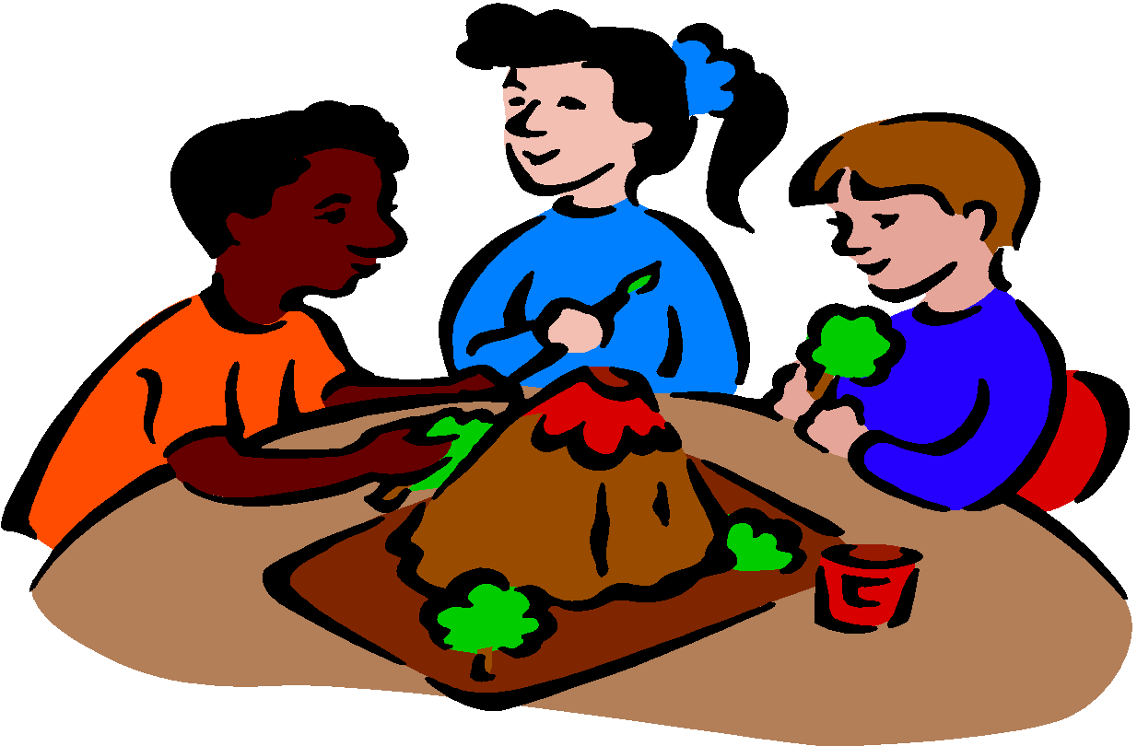
Teaching Four- and Five-year-olds
Observe
Model
Solicit children’s ideas:
Describe the situation
Ask open-ended questions
Teach children to expect to try again
Encourage children to describe their feelings to each other
Teach peers to prompt children
Prompt children
Redirect children with a brief, straightforward explanation when nothing else works
Notes:
This is just a reminder as we have discussed throughout the presentation.
Talk through the points on the slides and solicit any other point of discussion from the participants

Slide 46
Put It All Together…
Form groups of three
Assign a recorder
Read “What could you do?”
Identify the social behaviors not being used by the child(ren)
Identify how you would teach the behaviors
Notes:
Activity: Look at your handouts that describe the social behaviors and the teaching strategies. As we go through the scenarios, refer to these handouts to identify the social behaviors not being used and what strategies you would use to teach the behaviors.

Slide 47
What could you do? (Scenario 1)
In your class of two-year-olds, Zoe wants to dance with Ben. As the music plays, she runs over to him, grabs his hands and starts dancing. He pulls his hands away and screams.
Notes:
Scenario 1 (example)
What’s missing? Ability to enter in the dance
What skill would you teach? How to tap him on the shoulder and if verbal, use words to ask peer to dance (these can be used for verbal and non-verbal children).
Print the What Could You Do? scenarios that follow and distribute to group to review, discuss, and agree on a strategy to determine what social skills are lacking and how to teach the skill.
Presenter can come up with other examples on what’s missing and how to teach these skills.

Slide 48
What could you do? (Scenario 2)
A pair of two-year-olds are pulling on a cowboy hat and screaming, “It’s mine!”
A pair of four-year-olds are pulling on a cowboy hat and screaming, “It’s mine!”
Notes:
Sharing toys and other materials

Slide 49
What could you do? (Scenario 3)
On the playground several three- and four-year-olds are playing with hula hoops. A second group of children are standing off to the side waiting for a turn to use them. As time passes, the small group moves closer and begins to grab for the hula hoops. The children using them yell and scream in protest.
Notes:
Turn taking

Slide 50
What could you do? (Scenario 4)
Three-year-old Anna is painting at the easel. Four-year-old Sadie trips and falls into the easel and knocks Anna’s paints onto her picture. Anna clenches her fists and looks like she is going to hit Sadie.
Notes:
Understanding when and how to give an apology

Slide 51
What could you do? (Scenario 5)
In your class of four-year-olds, several boys are building with wooden blocks. One of the boys has piled all the long rectangular blocks next to him and will not share with the others. As you shift your attention to that area of the classroom you hear them ask several times followed by a loud and emphatic ”NO!” The boys are clearly frustrated with their peer.
Notes:
Sharing

Slide 52
What could you do? (Scenario 6)
You and a mother are talking while she holds her child in her arms. The mother’s two-year-old tries to talk to her. The mother keeps talking to you. The child gets louder and turns the mother’s face toward him.
Notes:
Teaching strategies for child may include getting attention, holding adult’s arm.
Teaching strategies for adult may include acknowledging child’s gaze, holding his hand, verbal reminder to wait.

Slide 53
Resources
National Center for Pyramid Model Innovations http://challengingbehavior.org
Pyramid Model Consortium http://www.pyramidmodel.org
Center on the Social and Emotional Foundations for Early Learning http://csefel.vanderbilt.edu/
Notes:
Here are some good Web sites that are related to social-emotional needs.

Slide 54
Thank You!
If you have any questions about the content in this module or need further assistance implementing a systems approach to early childhood inclusive practices, please contact the early childhood staff at the following T/TACs.
Regions 1 & 8 VCU 804-828-6947 or 434-292-3723
Regions 2 & 3 ODU 757-683-4333
Region 4 GMU 703-993-4496
Region 5 JMU 540-568-6746
Regions 6 & 7 VT 540-231-5167

